Slide 1
GAO’s High-Risk Area: Ensuring the Cybersecurity of the Nation
Nick Marinos Director Information Technology & Cybersecurity U.S. Government Accountability Office
April 2019

Slide 2
Agenda
Overview of GAO
High Risk Report - Cybersecurity Challenges and Urgent Actions to Address Them

Slide 3
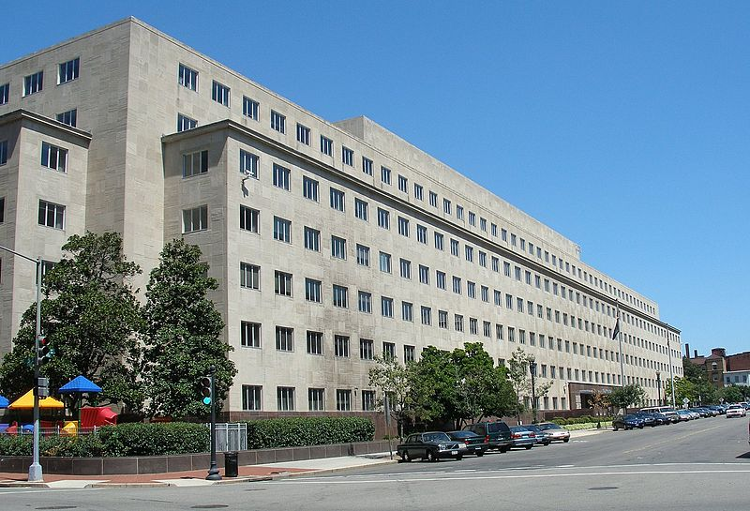
Overview – U.S. GAO

Slide 4
GAO’s Mission
GAO exists to support the Congress in meeting its constitutional responsibilities and to help improve the performance and ensure the accountability of the federal government for the benefit of the American people.
We provide Congress with timely information that is objective, fact-based, nonpartisan and non-ideological.
Notes:
GAO staff adhere to the agency’s core values, which help us meet our mission. The values are accountability, integrity, and reliability.

Slide 5
Core Values
Accountability
Help the Congress oversee federal programs, policies, and operations to ensure accountability to the American people.
Integrity
Ensure that our work is professional, objective, fact-based, nonpartisan and non-ideological.
Reliability
Provide high-quality, timely, accurate, useful, clear and candid information.

Slide 6
Evolution of Our Mission
Legal name becomes Government Accountability Office
General Accounting Office established
1921 1970 2004
Oversee
financial management
processes of the Executive Branch after WWI
+
Provide oversight
of program performance & government-wide issues
+
Expand portfolio to cover oversight, insight & foresight
Notes:
Original Mandate: “Investigate all matters relating to the receipt, disbursement, and appropriation of public funds”
Start with voucher auditing

Slide 7
The Modern GAO
Today, performance audits, program evaluations and policy analyses account for over 90 percent of GAO’s workload
GAO increasingly involved in a full range of oversight, insight and foresight activities
GAO has adopted a philosophy of “leading by example” and “partnering for progress”
Notes:
Vast majority of work is performance audits (about 700 reports per year)

Slide 8
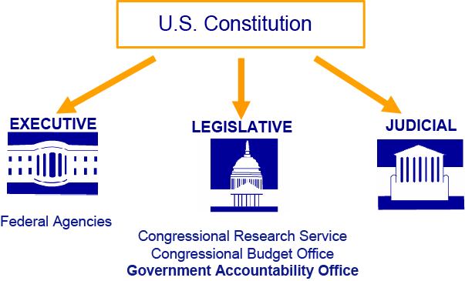
Three branches of U.S. Government
Notes:
Not subject to authority of Executive Branch Department heads

Slide 9
Comptroller General of the United States
Joint selection/appointment involving the Congress and the President
Removed only by impeachment
15-year term
Appointed on December 20, 2010
Term will end in 2025
Gene L. Dodaro
Notes:
Bipartisan Bicameral commission selects 3 nominees
President chooses 1
Senate confirms
Removed only by impeachment

Slide 10
What did GAO accomplish in FY18?
GAO’s FY18 achievements included, among others:
$75 billion in financial benefits
A return of $124 for every dollar invested in GAO
633 reports issued containing a total of 1,650 recommendations
98 testimonies before 48 separate Congressional committees
Notes:
GAO measures its performance using various indicators, such as number of products and testimonies, number of recommendations, and number of recommendations implemented
Agencies are required to report to congress on how they will implement recommendations
Because it takes a while for agencies to implement recs, GAO track recommendations over 4 year periods
Return of Investment was $124 dollars per $1 spent

Slide 11
GAO’s People
GAO’s staff are civil servants; none are political appointees
Approximately 3,000 staff
70% in Washington D.C. headquarters
30% in GAO’s 11 field offices
Staff have diverse academic training (public policy and administration, social sciences, accounting, computer science, law, etc.)
Certified public accountants (CPAs) conduct financial audits

Slide 12
About the IT & Cybersecurity (ITC) Team
IT Management Issues
Cybersecurity Issues
IT Management and Operations
Systems Acquisition and Development
IT Project Management
Information Management
Cybersecurity Strategy and Oversight
Federal Cybersecurity
Critical Infrastructure Cybersecurity
Data Protection and Privacy

Slide 13
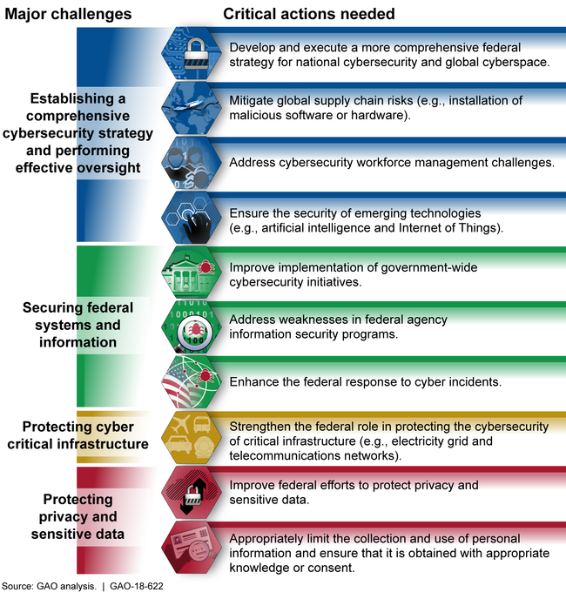
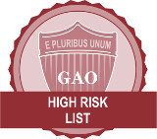
GAO’s Cybersecurity High Risk Area (introduced in 1997)

Slide 14
Recent Report
http://www.gao.gov/products/GAO-18-622

Slide 16
Challenge #1: Establishing a Comprehensive Cybersecurity Strategy and Performing Effective Oversight
“[Recent] efforts provide a good foundation toward establishing a more comprehensive strategy, but more effort is needed to address all of the desirable characteristics of a national strategy.” GAO‑18-645T
“If global IT supply chain risks are realized, they could jeopardize the confidentiality, integrity, and availability of federal information systems.” GAO‑18-667T
“Agencies had not effectively conducted baseline assessments of their cybersecurity workforce or fully developed procedures for coding positions.” GAO‑18-466
“IoT devices that continuously collect and process information are potentially vulnerable to cyber-attacks.” GAO‑17‑75

Slide 17
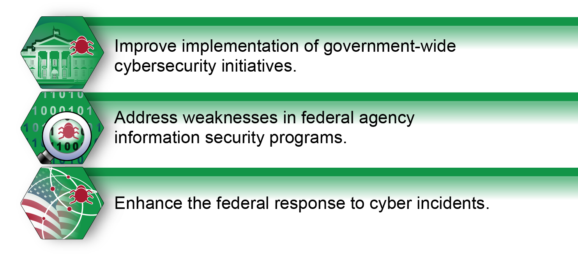

Slide 18
Challenge #2: Securing Federal Systems and Information
“While agencies have gotten better at preventing and detecting intrusions into their systems, they are still vulnerable to attacks such as "phishing"—emails designed to trick staff into clicking malicious links. Moreover, many agencies have not yet fully implemented effective security programs or practices, leaving them vulnerable to future attacks.” GAO-19-105
“We reported numerous deficiencies in CDC's information security program and controls that CDC used to identify risk, protect systems, detect and respond to cybersecurity events, and recover operations after such events.” GAO-19-70

Slide 20
Challenge #3: Protecting Cyber Critical Infrastructure
“The nation depends on the interstate pipeline system to deliver oil, natural gas, and more. This increasingly computerized system is an attractive target for hackers and terrorists.” GAO-19-48
“The Department of Homeland Security (DHS) had not measured the impact of its efforts to support cyber risk reduction for high-risk chemical sector entities.” GAO‑18-211
“The federal government had identified major challenges to the adoption of the cybersecurity framework.” GAO‑18-211
“Major challenges existed to securing the electricity grid against cyber threats.” GAO‑16-174

Slide 22
Challenge #4: Protecting Privacy and Sensitive Data
“CMS and external entities were at risk of compromising Medicare Beneficiary Data due to a lack of guidance and proper oversight.” GAO‑18‑210
“The Equifax breach resulted in the attackers accessing personal information of at least 145.5 million individuals.” GAO‑18‑559
“The emergence of IoT devices can facilitate the collection of information about individuals without their knowledge or consent” GAO‑17‑75
“Smartphone tracking apps can present serious safety and privacy risks.” - GAO‑16‑317

Slide 23
Challenges in Evaluating Cybersecurity
1. Challenge: Obtaining timely access to people, systems, and information
Agency use of audit liaison personnel
Agency reliance on contractors
Sensitivity of data
GAO’s response: setting expectations at entrance conferences, dual communications, escalation protocols, involvement of agency contracting technical representative, security controls over agency data, data sensitivity reviews, and separate reporting suitable for public release
2. Challenge: Hiring, developing, and retaining auditors with cyber skills
Demand exceeds supply
GAO’s response: recruiting alliances with universities, internships, career path, professional development programs, work/life balance initiatives

Slide 24
The Questions That Keep Coming Up on the Audit Trail
Does the agency know its IT environment?
Are security and privacy risks routinely and inclusively assessed by the agency?
Are tests of the effectiveness of automated security protections performed?
Is information on known weaknesses and vulnerabilities shared with agency leadership?

Slide 25
GAO on the Web
Web site: http://www.gao.gov/
Congressional Relations
Orice Williams Brown, Managing Director, williamso@gao.gov
(202) 512-4400, U.S. Government Accountability Office 441 G Street, NW, Room 7125, Washington, DC 20548
Public Affairs
Chuck Young, Managing Director, youngc1@gao.gov (202) 512-4800, U.S. Government Accountability Office 441 G Street, NW, Room 7149, Washington, DC 20548
Copyright
This is a work of the U.S. government and is not subject to copyright protection in the United States. The published product may be reproduced and distributed in its entirety without further permission from GAO. However, because this work may contain copyrighted images or other material, permission from the copyright holder may be necessary if you wish to reproduce this material separately.

